Slide 1
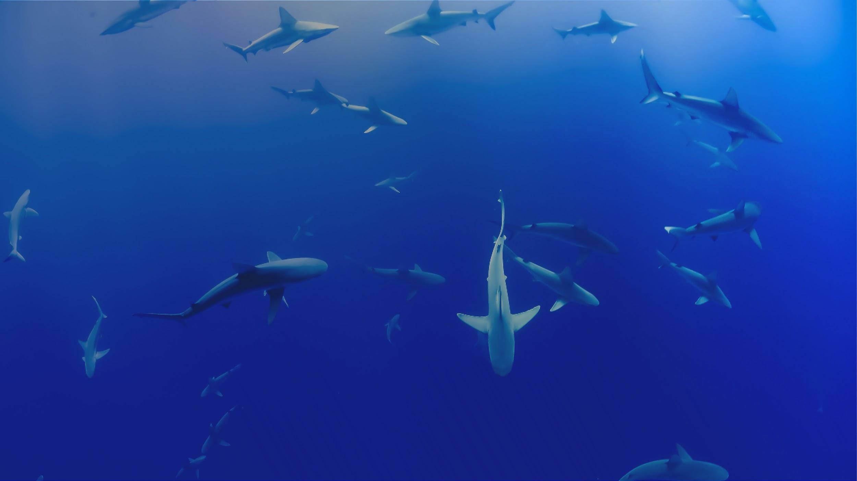


Which analysis should I use?
Kim Whoriskey
X
kwhoriskey@dal.ca
@kimprobable42

Slide 2
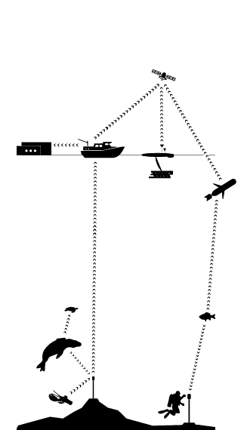
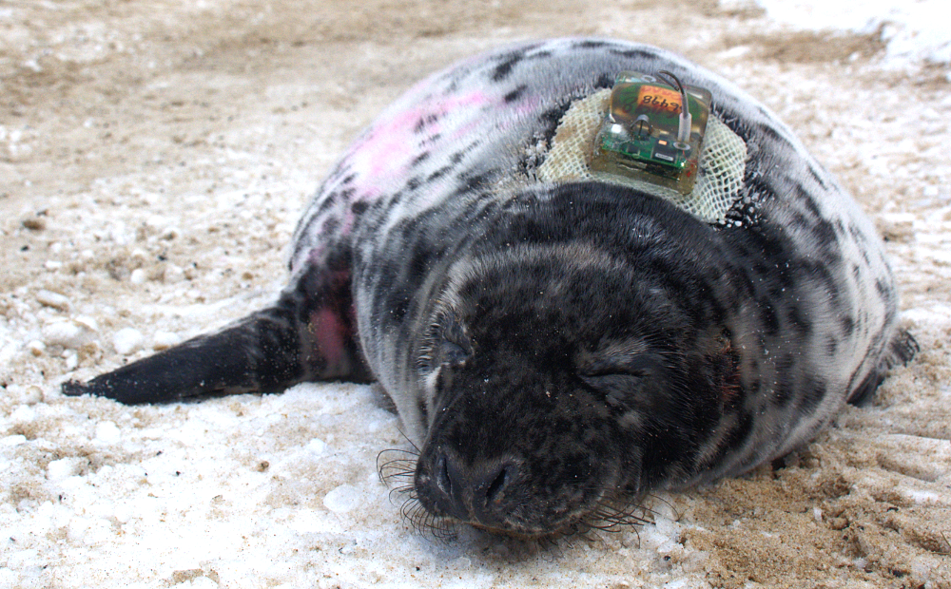
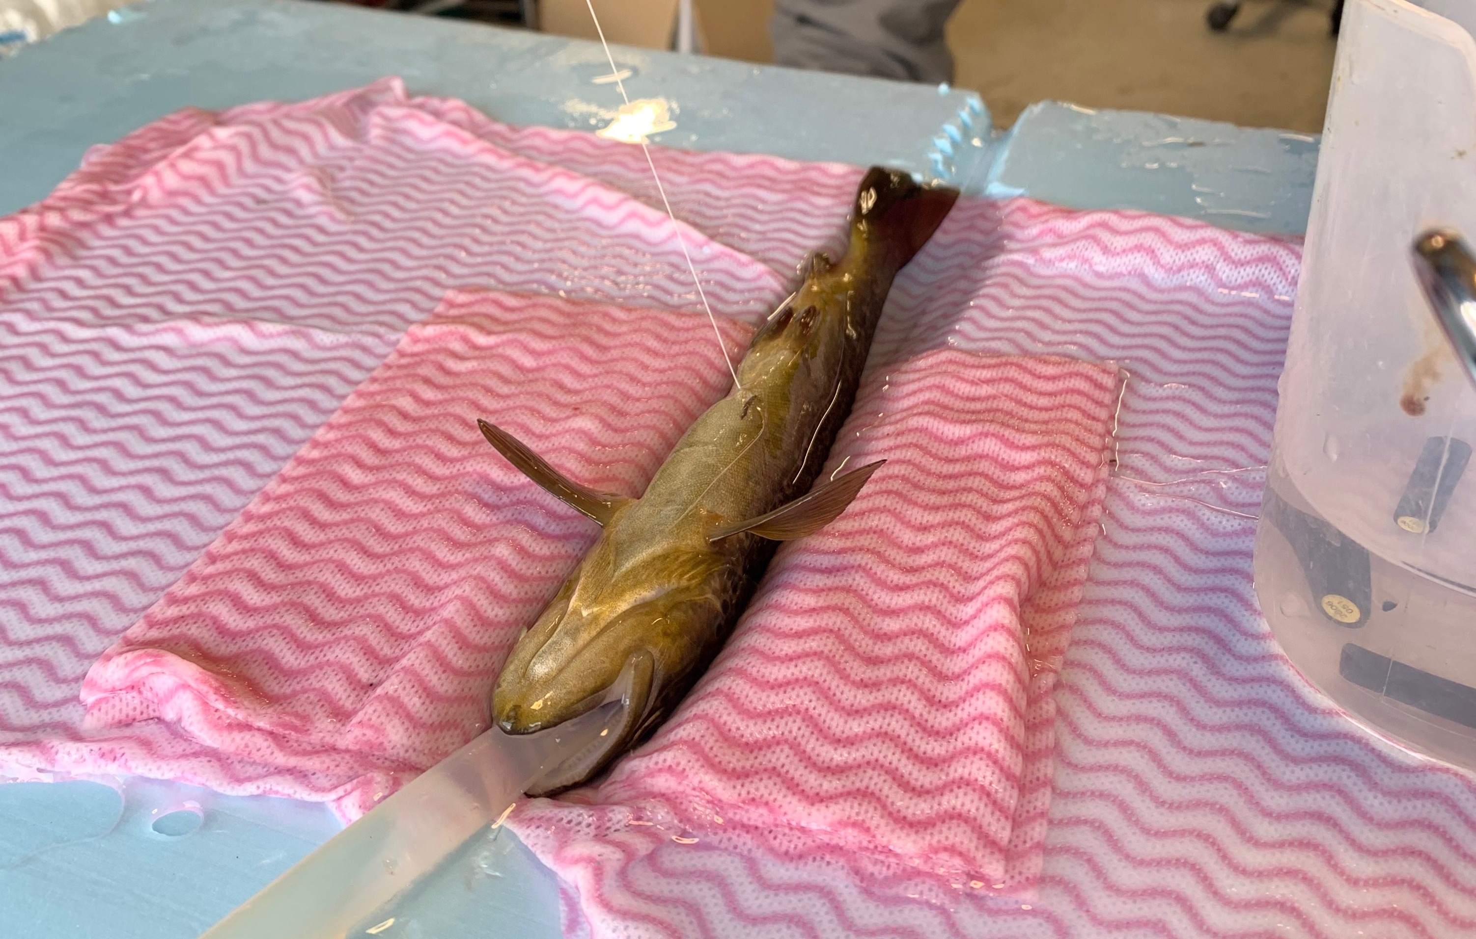
Aquatic telemetry
My seal
Rob Lennox’s fish

Slide 3
Aquatic telemetry
Satellite
Acoustic
Spatially Continuous
Spatially Discrete

Slide 4
Data challenges with detections

Slide 5
Data challenges with detections
Spatially discrete (regular)
Biased (towards receiver locations)
Just measures presence (and sometimes we miss it), we infer absence
The meaning of “presence” is dynamic because detection ranges change over time and space
A single data unit can lead to multiple observations (overlapping detection ranges)
Collisions can lead to false detections

Slide 6
Telemetry stats 101
The goal
The response variable
The method

Slide 7
Stats is easy-peasy
The goal
The response variable
The method

Slide 8
Stats is easy-peasy … kinda
The goal
The response variable
The method

Slide 9
Stats is easy-peasy … kinda … meh
Assumptions
Study design
The goal
Computational Power
Covariates
The response variable
Data loss/gaps
The method
Autocorrelation in space/time
Personal/coauthor preference

Slide 10
Okay it’s not, but this is a good place to start!
The goal
The response variable
The method

Slide 11

The goal
What do I want to know about my animal?
Timing of migration?
Distribution in an area?
Lateral movements down a river?
Survival of my population?
Repeatability of behaviours?
Niche partitioning?
Association with conspecifics?
Spawning behavior?
Population size?
Influence of anthropogenic activities?

Slide 12
The goal
What do I want to know about my animal?
Timing of migration?
Distribution in an area?
Lateral movements down a river?
Survival of my population?
Repeatability of behaviours?
Niche partitioning?
Association with conspecifics?
Spawning behavior?
Population size?
Influence of anthropogenic activities?
Frames the rest of the analysis
Automatically eliminates some possible methods
Sets up the infrastructure for inference/hypothesis tests

Slide 13

The response variable
Detection data are incredibly versatile
You can calculate (e.g.):
Presence/absence
Detection “events”
Residency indices
Total distance travelled
Total time until an event (e.g., passage through dam/estuary)
Connections among tagged individuals or sites
Counts of individuals
This can be done over both time and space!

Slide 14
The response variable
Detection data are incredibly versatile
You can calculate (e.g.):
Presence/absence
Detection “events”
Residency indices
Total distance travelled
Total time until an event (e.g., passage through dam/estuary)
Connections among tagged individuals or sites
Counts of individuals
This can be done over both time and space!
A series of numbers that represent your animal behaviour
You use these numbers to test hypotheses about your animals
Needs to take on a specific structure for your chosen model

Slide 15

The method
There is no one-size-fits-all method
Some methods are better suited for specific combinations of goals/response variables
(that is one way that the method can actually help you tweak your goal/response)
In reality, many methods can be used to achieve a single goal
This redundancy may seem annoying, but it’s actually a really powerful tool for testing hypotheses
In addition, most branches of statistics can be related to one another if you delve deep enough

Slide 16
The method
There is no one-size-fits-all method
Some methods are better suited for specific combinations of goals/response variables
(that is one way that the method can actually help you tweak your goal/response)
In reality, many methods can be used to achieve a single goal
This redundancy may seem annoying, but it’s actually a really powerful tool for testing hypotheses
In addition, most branches of statistics can be related to one another if you delve deep enough
A suite of statistical rules that you can use to test ecological hypotheses
Always comes with assumptions that need to be checked!

Slide 17
Some methods we’ll briefly go over …
Generalized models
Survival Analysis
Mark Recapture
Network Analysis
Machine Learning
Triangulation

Slide 18
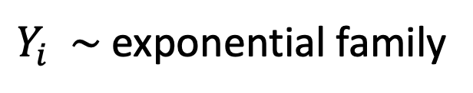
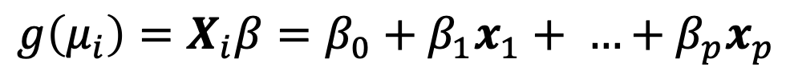
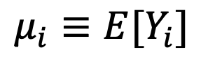
Generalized models
The goal
To estimate the association and its significance between different measured variables
Home range areas, presence/absence, distance travelled, number of animals, etc…
The response
$Y_{i} \sim$ exponential family
$$μ_{i}≡E[Y_{i}]$$
$$g\left(μ_{i}\right)=X_{i}β=β_{0}+β_{1}x_{1}+ …+β_{p}x_{p}$$
Notes:
Hugely

Slide 19
Generalized models – an example ...
Gutowsky et al. 2016. Interactive effects of sex and body size on the movement ecology of adfluvial bull trout (Salvelinus confluentus). CJFAS. doi:10.1139/cjz-2015-0104
https://www.fws.gov/oregonfwo
Whoriskey et al. 2019. doi:10.1111/2041-210X.13188

Slide 20
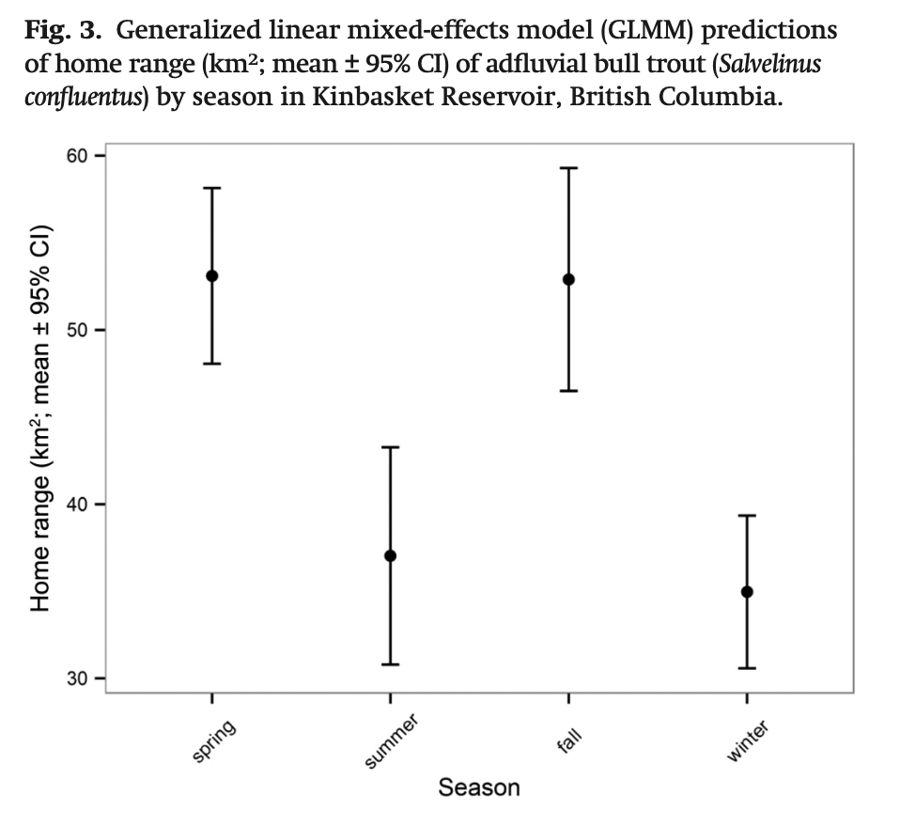
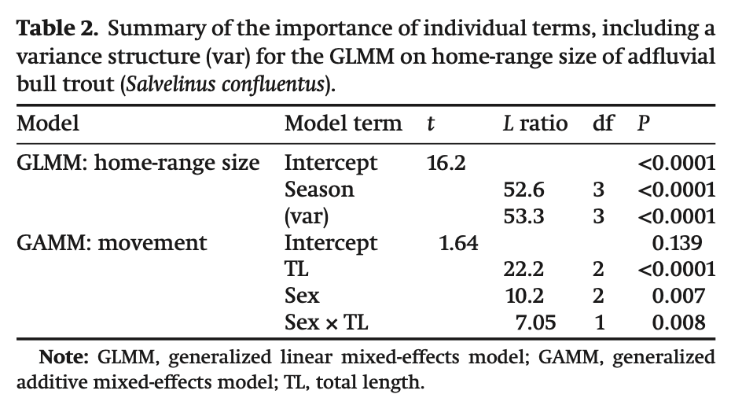
Generalized models – an example ...
The goal
The goal:
Quantify movement patterns over seasons and between sexes
Home ranges, and total displacement
The response
Gutowsky et al. 2016.

Slide 21
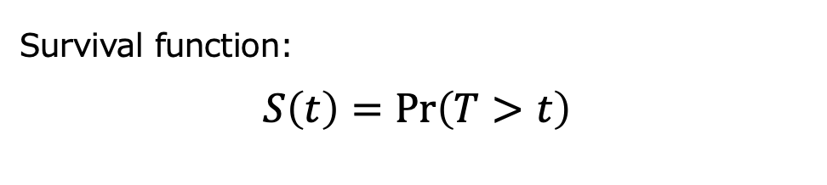
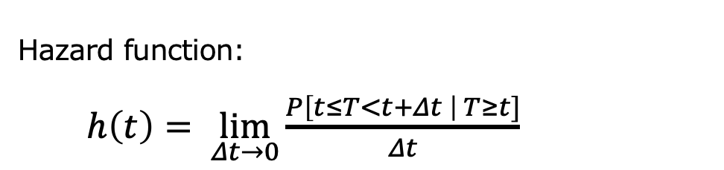
Survival analysis
The goal
Determine the factors significantly associated with an important ecological event
The time it took for the event to occur, or a value indicating that the study ended before the event could occur (censoring)
The response
Hazard function:
$h\left(t\right)= \lim_{Δt→0}{\frac{P\left[t≤T<t+Δt \right| T≥t]}{Δt}}$
Survival function:
$$S\left(t\right)=\operatorname{Pr}\left(T>t\right)$$

Slide 22
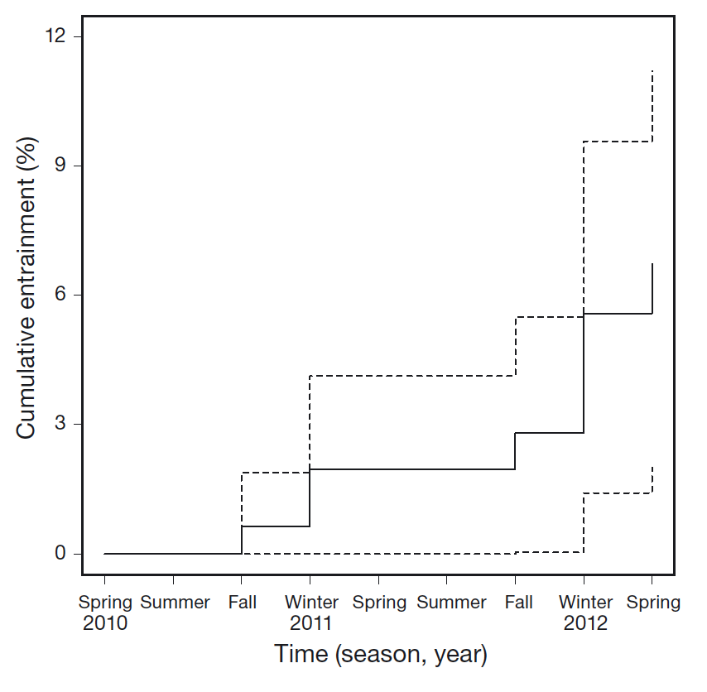
Survival analysis – an example …
The goal
Determine whether season is associated with bull trout dam entrainment
Time to entrainment
The response
Fig 3. Martins et al. 2013. doi: 10.3354/ab00536
https://www.fws.gov/oregonfwo

Slide 23
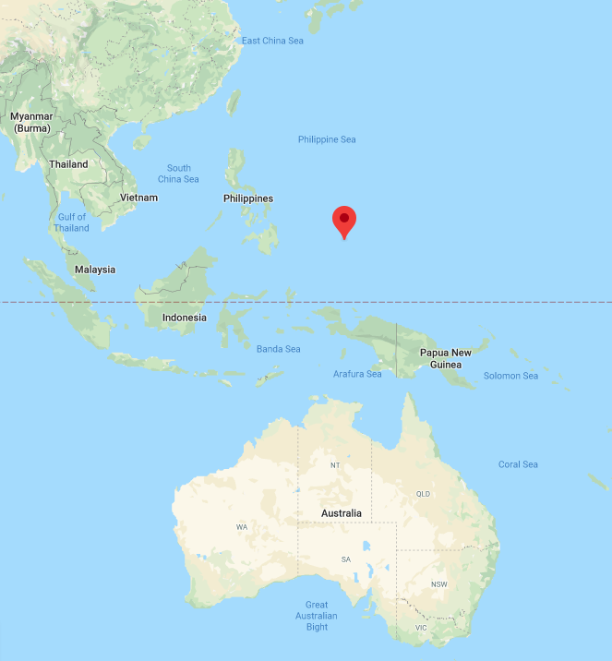
Survival analysis – an example …
Filous et al. 2020. Movements of juvenile yellowfin tuna (Thunnus albacares) within the coastal FAD network adjacent to the Palau National Marine Sanctuary: Implications for local fisheries development. Fisheries Research 230: 105688.
maps.google.com

Slide 24
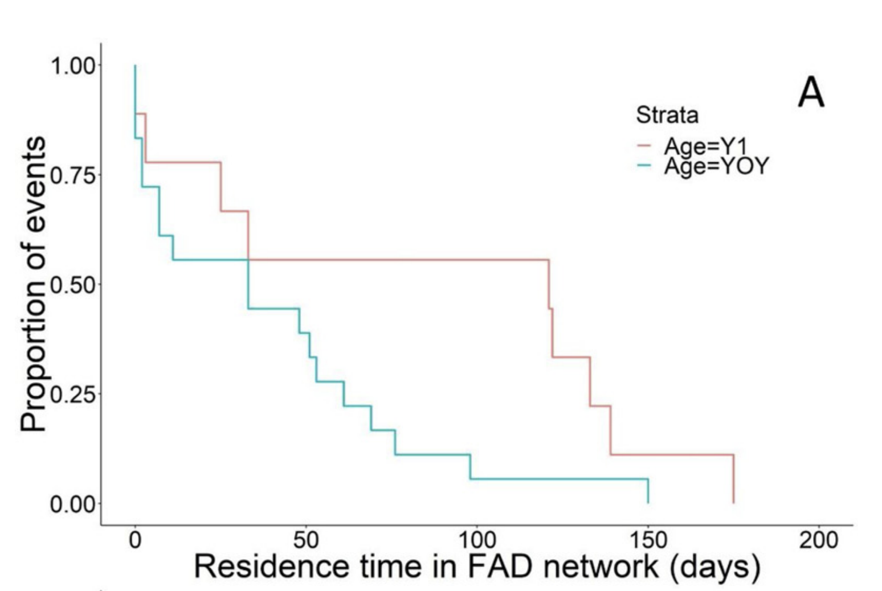
Survival analysis – an example …
The goal
quantify the difference in retention time within the FAD network between young-of-year and year 1 tuna
The response: the time it took for a tuna left the FAD network
The response
Fig 3

Slide 25
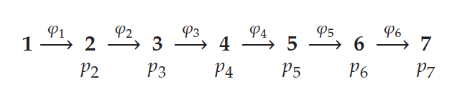
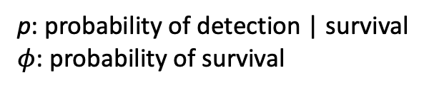
Mark-recapture analysis
The goal
can be used to estimate population dynamics or movement, e.g., population size or survival, especially when you want to account for detection efficiency issues
The response variable: a series of 0s and 1s describing whether an animal was detected at each time point or not.
The response
p: probability of detection | survival
$φ$: probability of survival

Slide 26
Mark-recapture – an example …
The goal
estimate survival and probability of detection of bull trout within the Kinbasket reservoir
character strings of 0s and 1s denoting absence and presence respectively per day, e.g., 10001110
Model Formula | # Parameters | AICc | DeltaAICc
Φ(~1)p(~1) | 2 | 258.0 | 0.00
Φ(~length)p(~1) | 3 | 259.4 | 1.41
Φ(~sex)p(~1) | 3 | 260.0 | 2.02
Φ(~sex * length)p(~1) | 5 | 260.6 | 2.59
Φ(~sex + length)p(~1) | 4 | 261.5 | 3.42
Φ(~1)p(~time) | 4 | 261.5 | 3.50
Φ(~length)p(~time) | 5 | 263.3 | 5.29
Φ(~sex)p(~time) | 5 | 263.6 | 5.58
Φ(~sex * length)p(~time) | 7 | 264.6 | 6.57
Φ(~sex + length)p(~time) | 6 | 265.4 | 7.39
The response
Table 1. Whoriskey et al. 2019. doi:10.1111/2041-210X.13188

Slide 27
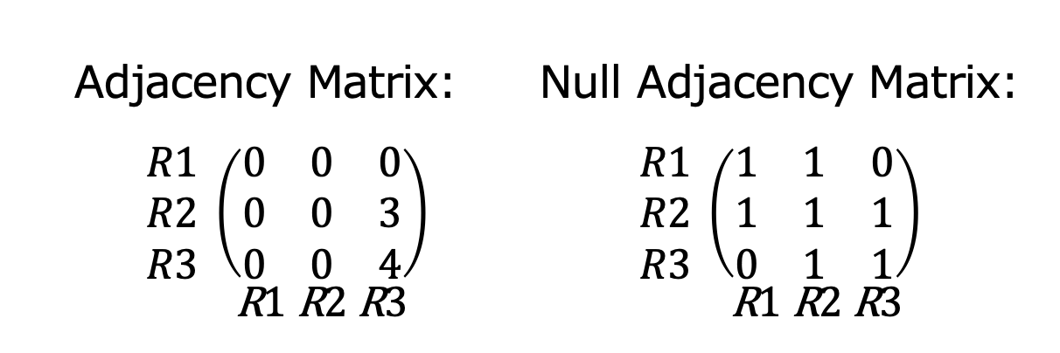
Network analysis
The goal
assess the connectivity of a system (either receivers or animals or both)
adjacency matrices describe the edges among your nodes
The response
Adjacency Matrix: Null Adjacency Matrix:
$\begin{matrix}R1 \\ R2 \\ R3\end{matrix} \left(\begin{matrix}0 & 0 & 0 \\ 0 & 0 & 3 \\ 0 & 0 & 4\end{matrix}\right)$ $\begin{matrix}R1 \\ R2 \\ R3\end{matrix} \left(\begin{matrix}1 & 1 & 0 \\ 1 & 1 & 1 \\ 0 & 1 & 1\end{matrix}\right)$
R1 R2 R3 R1 R2 R3

Slide 28
Network analysis – an example …
The goal
assess which areas are important for bull trout
nodes constitute receivers
weighted here by the degree: the number of incoming and outgoing edges at each receiver
edges are weighted by the number of movements between the receivers
The response

Slide 29
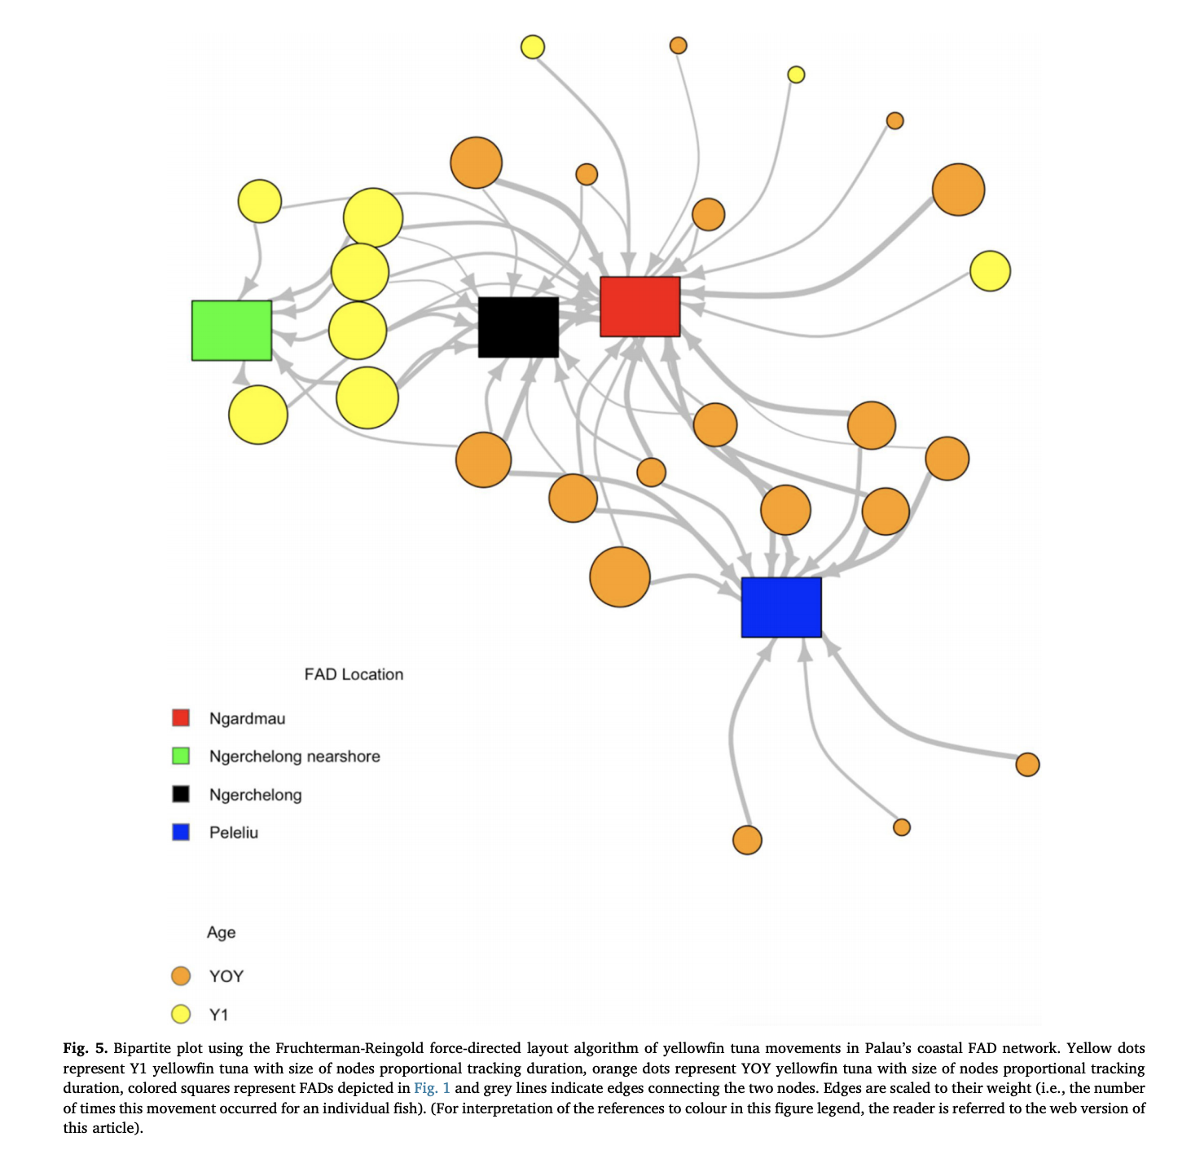
Meanwhile in Palau (Filous et al. 2020) …
The goal
Assess the connectivity of tuna with individual FADs
A bipartite graph
Nodes correspond to both tagged tuna and individual receivers
Edges described the number of times a fish moved to that FAD
The response
Fig 5
Notes:
Ngardmau (red) had the highest degree (number of individuals visiting

Slide 30
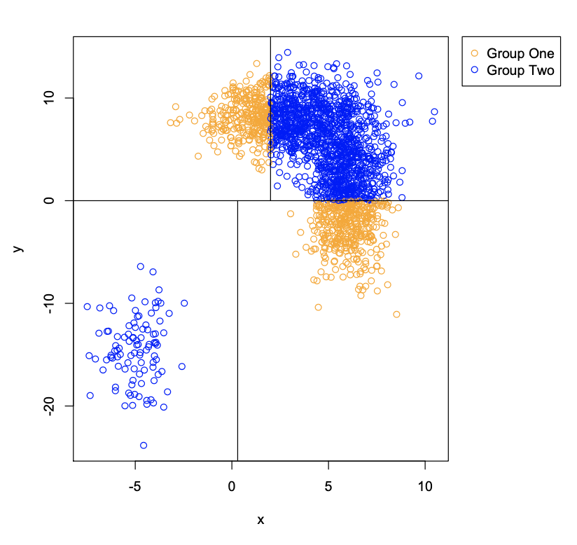
Machine learning – Random Forests
The goal
classifying data into groups (not as interested in the relationships that force the classification)
the group, e.g, predated vs. not predated, habitat choices, out-migrants vs non-migrants (but technically the model input can include things like movement metrics, age, length, sex, etc…)
The response
cred: Jonathan Babyn

Slide 31
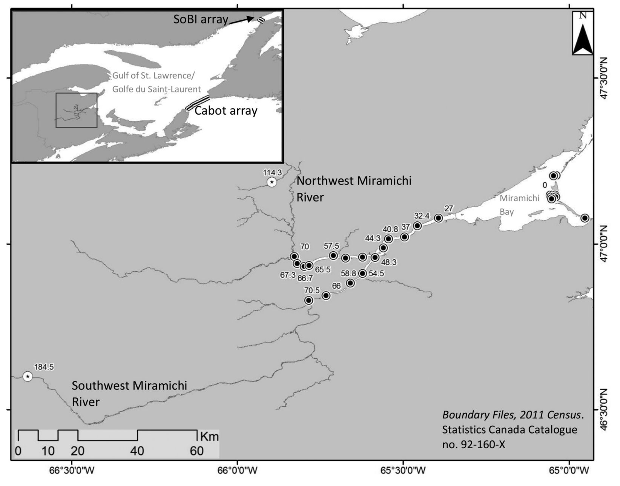
Random Forests - an example ...
Daniels et al. 2018. Estimating consumption rate of Atlantic salmon smolts (Salmo salar) by striped bass (Morone saxatilis) in the Miramichi River estuary using acoustic telemetry. CJFAS. doi:10.1139/cjfas-2017-0373
http://www.cosewic.ca/
Striped Bass © Steven G. Johnson.
Fig 1.

Slide 32
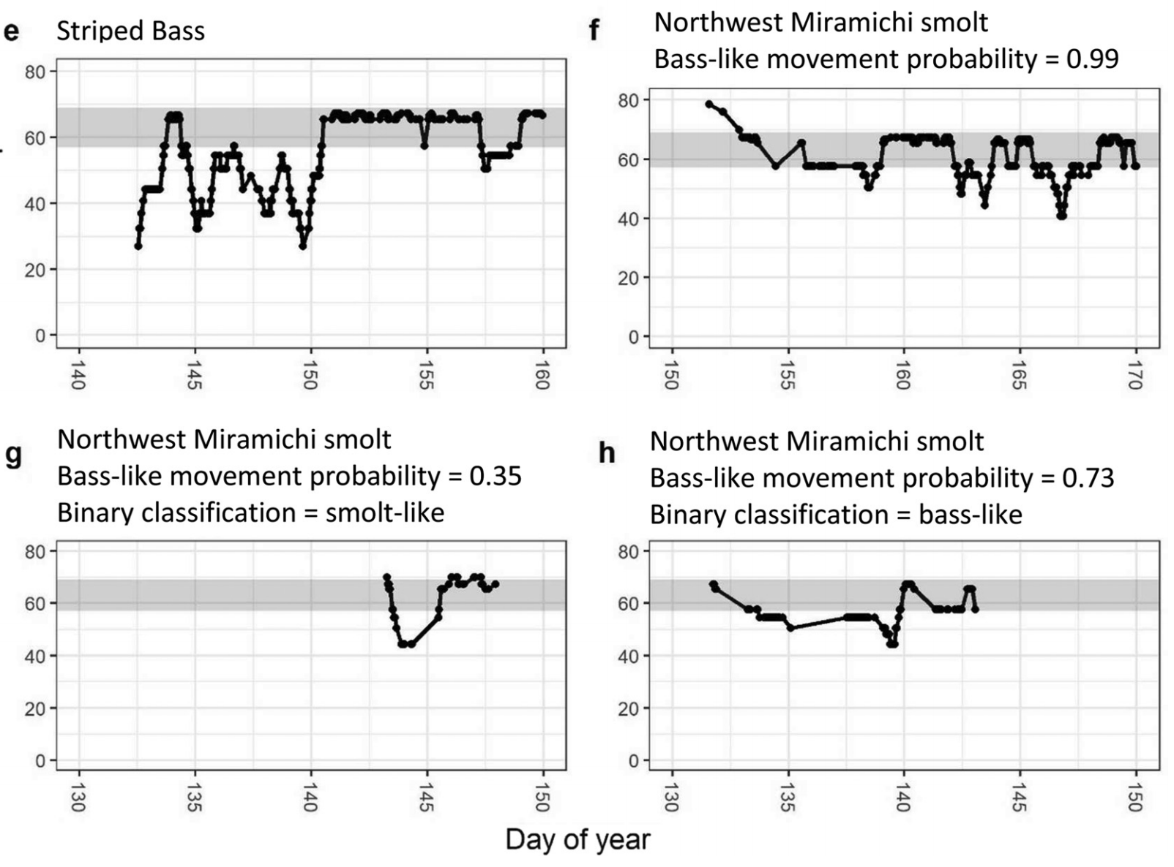
Random Forests - an example ...
The goal
classify tagged smolt movement data into either predated or not predated
The response: 8 movement metrics from known fate smolt, known fate bass, and unknown fate smolt data
The response

Slide 33
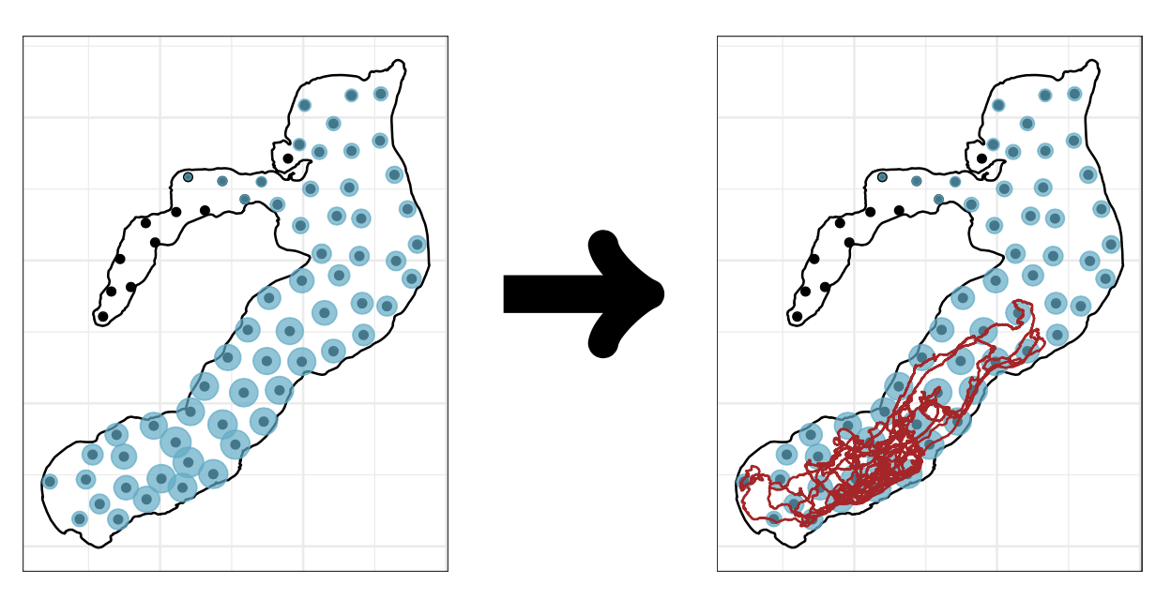
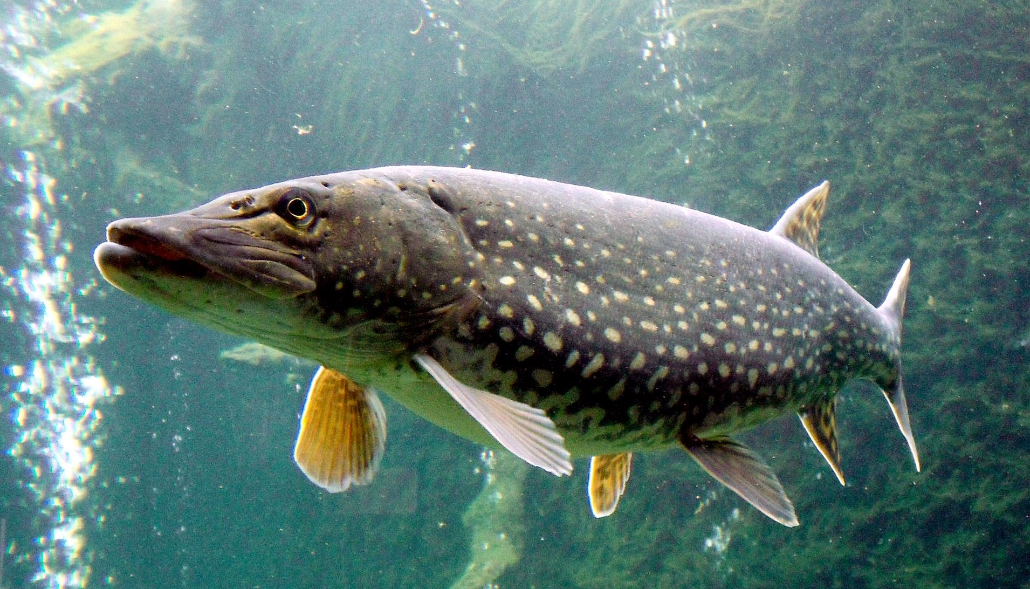
Triangulation
By Jik jik - Own work,CC BY-SA 3.0, https://commons.wikimedia.org/w/index.php?curid=14631780
Whoriskey et al. In prep. YAMS.

Slide 34
Triangulation

Slide 35
Triangulation
The goal
estimate or predict the underlying animal path
your raw detection data
The response

Slide 36
Triangulation
The goal
estimate or predict the underlying animal path
your raw detection data
Different methods: VPS, COAs, YAPS, …
Opens up a whole other suite of tools that can be used to study animal ecology including HMMs, RSFs, home range analyses, …
The response

Slide 37

Thanks!
Whoriskey et al. 2019. doi:10.1111/2041-210X.13188
Eduardo Martins
Marie Auger-Méthé
Lee Gutowsky
Robert Lennox
Steven Cooke
Michael Power
Joanna Mills Flemming
X
Notes:
canssilogoreverse.png

